Slide 1
heteroskedasticity
Econ 441 2019 Fall

Slide 2
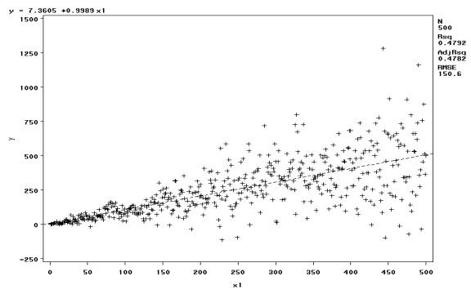
heteroskedasticity
Opposite of homoscedasticity (Ass. 5: V[U|X] independent of X)
How to detect it?
Scatter plot of Y, X: the cloud does not have a shape of a uniform band, it has bumps, or increasing in width as we increase X

Slide 3
heteroskedasticity
Consequences of heteroskedasticity for OLS
OLS still unbiased and consistent under heteroskedastictiy!
Also, interpretation of R-squared is not changed
Heteroskedasticity invalidates variance formulas for OLS estimators
The usual F tests and t tests are not valid under heteroskedasticity

Slide 4
How to fix it?
You need to estimate heteroskedasticity-robust (White) standard errors
In practice: regress y x1 x2 x3, robust
Using these formulas (the White standard errors), the usual t test is valid asymptotically
The usual F statistic does not work under heteroskedasticity, but heteroskedasticity robust versions are available in most software

Slide 5
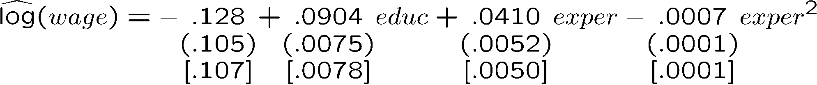
example
Why is this bad?
Often the White standard errors (the robust standard errors) are higher than the simple OLS standard errors
You may establish significance where there is no significance

Slide 6
Testing for heteroskedasticity 1
It may still be interesting whether there is heteroskedasticity because then OLS may not be the most efficient linear estimator anymore
Breusch-Pagan test for heteroskedasticity
MEASURE THE DISCREPANCY BETWEEN THE TWO! If 0, homoscedasticity, if not, then not!

Slide 7
Testing for heteroskedasticity 2
White test:
Calculate the residuals from the OLS regression
Regress the residuals on squares and interactions of RHS variables
Test if the coefficients are JOINTLY zero

Slide 8
Testing in Stata
Always use a regress command first!
Breusch-Pagan test:
estat hettest
OR
bpagan educ exper exper_sq
White-test
imtest, white

